Slide 1
Project Management with GitHub
CSCE3444
By Renugopal Sivaprakasam

Slide 2
TABLE OF CONTENTS
01
02
03
04
05
06
Github
How can we use?
User Stories, Tasks and Spikes
Progressive Web App
Tips on PWA
Resources

Slide 3


What is Git and Github?
Git is a distributed version control system (VCS) used to track changes to code locally,
whereas GitHub is a cloud-based hosting service for Git repositories that adds collaboration and management features.

Slide 4
How can we use GitHub For Project Management
Centralized Task Tracking:
Use GitHub Issues to log tasks, bugs, and feature requests, making it easy to track progress and maintain accountability.
Visual Workflow Management:
Leverage GitHub Projects (Kanban-style boards) to organize work into columns like "To Do," "In Progress," and "Done," providing a clear overview for your team.
Integrated Code Reviews:
Tie pull requests to issues so that every piece of work is reviewed and linked to a specific task, ensuring code quality and consistency.
Workflow Automation:
Utilize GitHub Actions to automate routine tasks such as labeling, testing, and deployments, which helps streamline your project’s workflow.

Slide 5
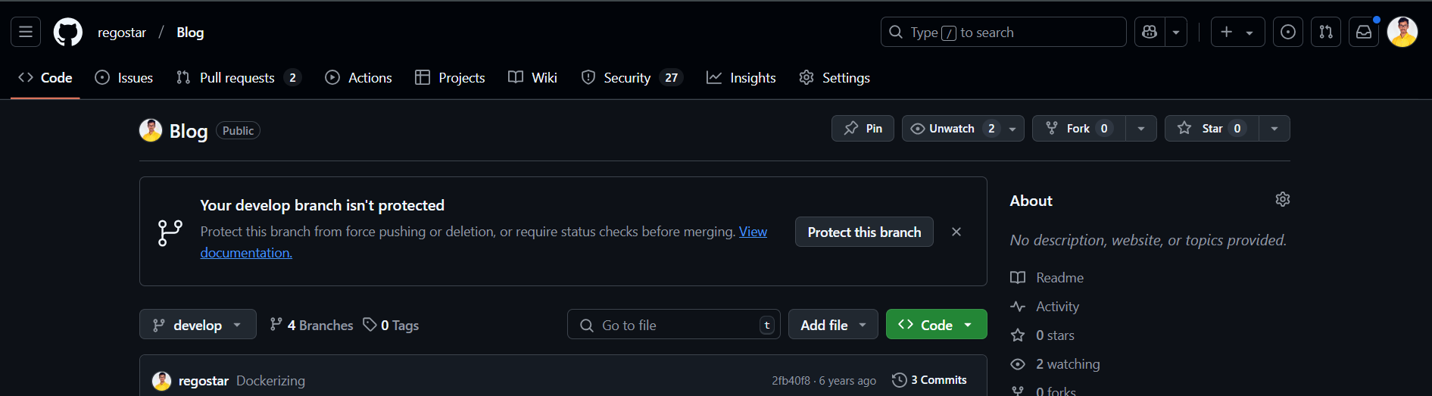
Let’s see it in action
Step 1: How to create a Project
Create a Repository https://docs.github.com/en/repositories/creating-and-managing-repositories/quickstart-for-repositories
Open the repository and click on Projects tab
Click on Create new Project
Select Iterative Development/Kanban preferably.
You will see a Github Project created with a new board

Slide 6
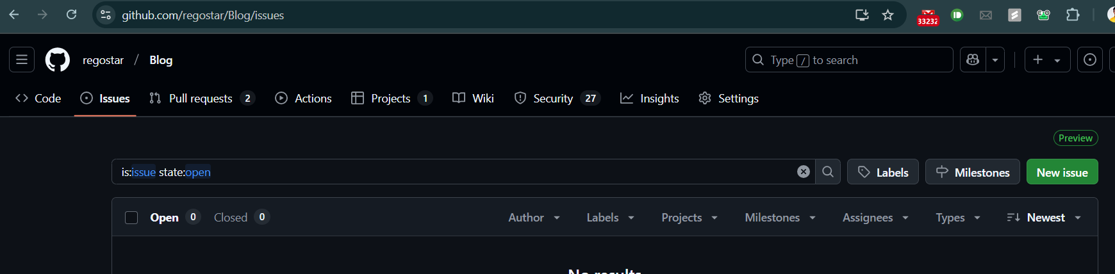
Step 2: How to create a User Story
Open Your Repository and click on Issues
Create User Story - General format of user stories: As a ...., I want to ....., so that..... Refer Slides - 3-Agile Software Engineering

Slide 7
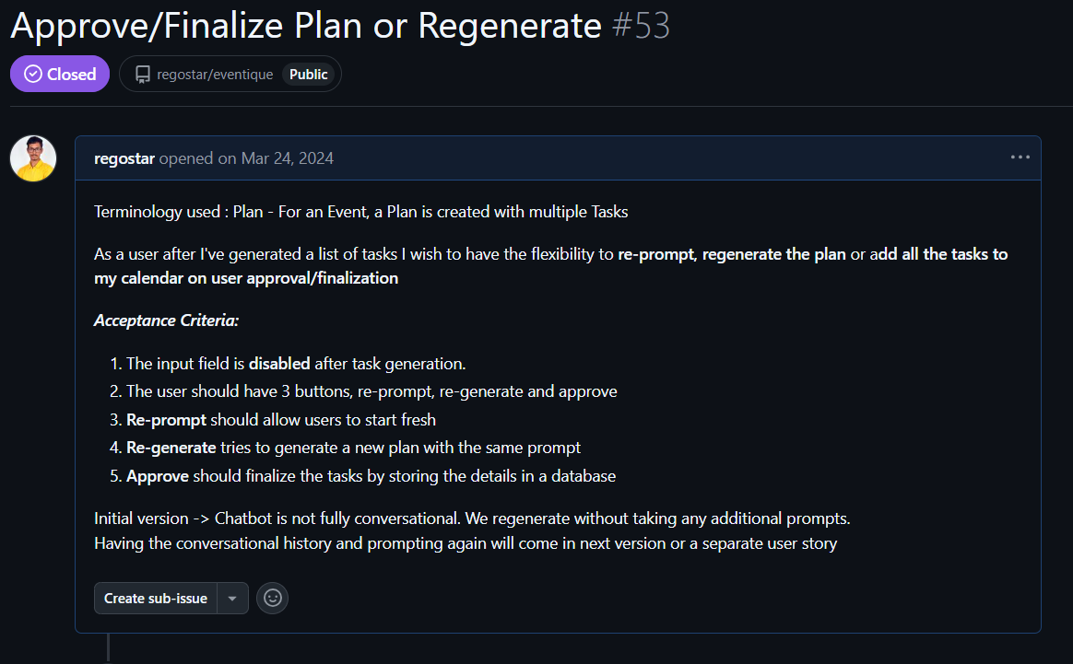
Example of User Story

Slide 8
Step 2: How to create a User Story
User stories must be:
• non-technical and from the user perspective
• independent (from other stories) and self-sufficient
• Valuable (meaningful) stories: add a value to the project
• negotiable (i.e., can be changed at any time upon need)
• estimable- must be descriptive and small, so we can estimate the work for it.
Each user story must have one or more acceptance criteria
Source - Class slides - 3-Agile Software Engineering

Slide 9
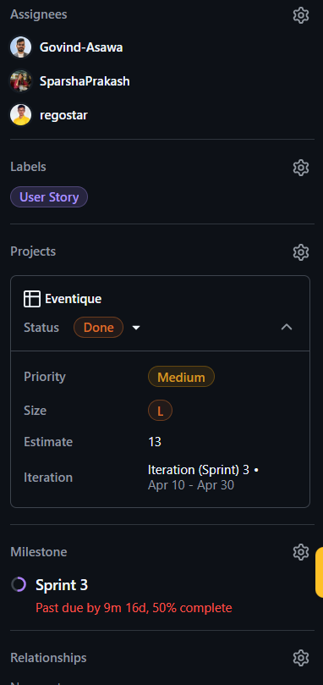
Step 2: How to create a User Story
Assignees
Assignees are team members assigned to work on the task.
Labels
Labels help categorize issues. You can Label it as User Story, Task, or Spike.
Status
Status reflects the current progress of the task. Todo, In Progress, Done
Priority
Priority ranks the urgency or importance of the task. Low, Medium, High

Slide 10
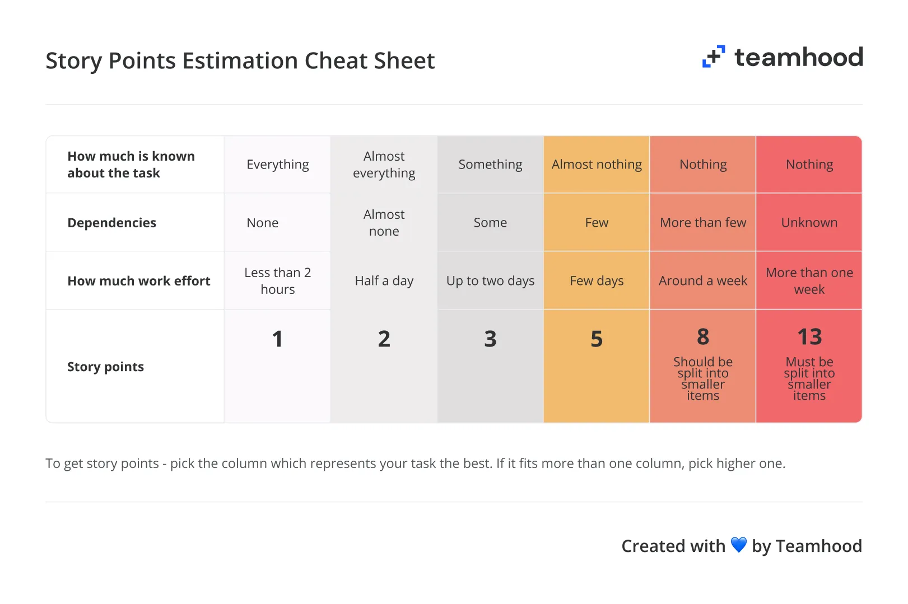
Step 2: How to create a User Story
Estimate
Estimate provides a quantified value (usually in story points) expected to complete the task.

Slide 11
Step 2: How to create a User Story
Iteration (Sprint)
Iteration (Sprint) shows the specific time frame (sprint) allocated for the task. Can use it to signify Sprint 1, Sprint 2, Sprint 3
Milestone
Milestone marks significant checkpoints or phases within the project.
Can use it to signify Sprint 1, Sprint 2, Sprint 3
Example :-
https://github.com/users/regostar/projects/1/views/6?pane=issue&itemId=57455387&issue=regostar%7Ceventique%7C53

Slide 12
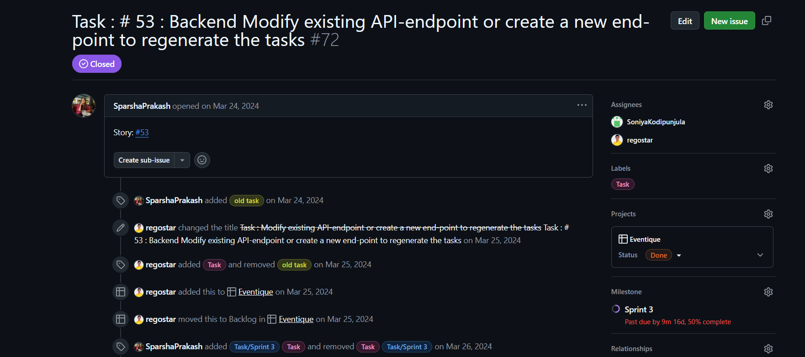
Step 3: How to create a Task
Add the User story number in the title. Then specify what exactly needs to be done with as much details as possible. Add respective tags.

Slide 13
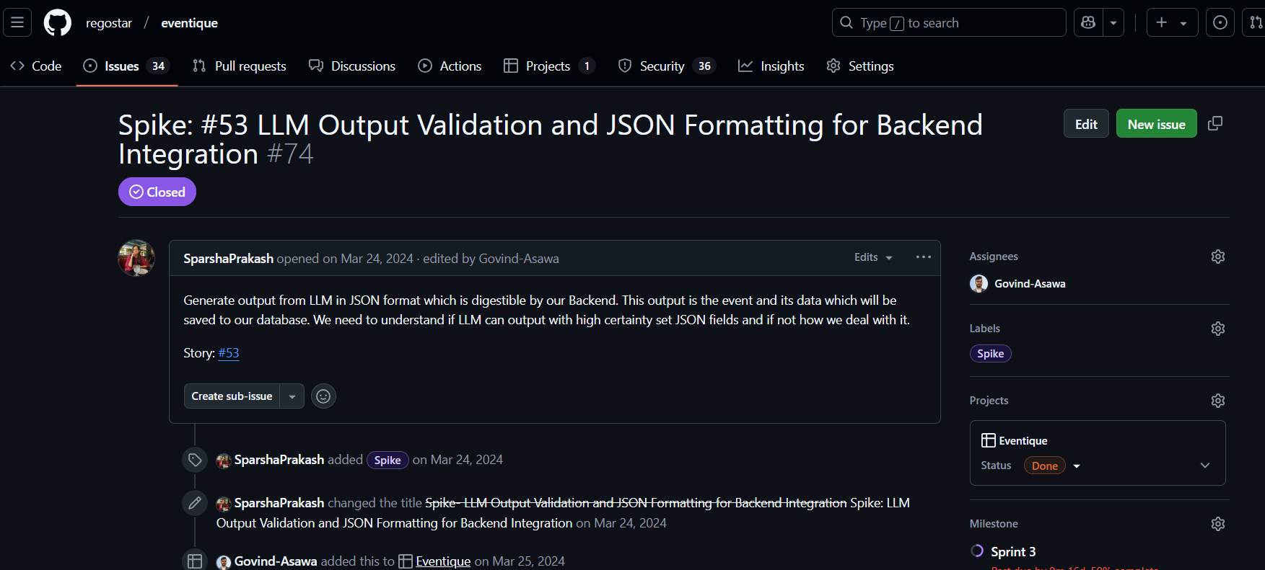
Step 4: How to create a Spike
Add the User story number in the title. Then specify what exactly needs to be Researched in a timeboxed fashion. Add respective tags.

Slide 14
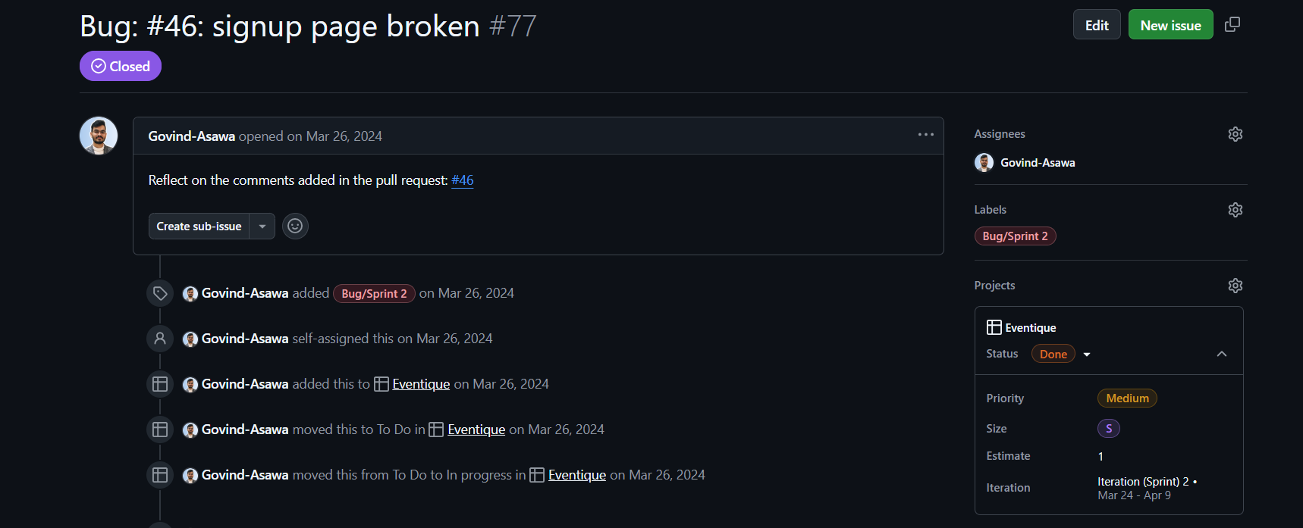
Step 4: How to create a Bug
Add the User story number in the title. Then specify what exactly is broken and how to replicate it. Add respective tags.

Slide 15
Best Practices for Managing Scrum in GitHub Projects
Clear Communication
Use detailed issue descriptions and regular comments for transparency.
Integrate with communication tools (e.g., Slack) for real-time updates.
Consistent Updates
Keep the board updated daily during standups.
Regularly review and reprioritize the backlog.
Documentation
Document the process, including definitions for tasks, user stories, and spikes.
Maintain a project wiki or use repository-level README for guidelines.
Retrospectives
After each sprint, review board metrics to identify improvements.
Adjust configurations and workflows to better support the team’s needs.

Slide 16
Progressive Web Application
Progressive Web Apps (PWAs) are a type of application software delivered through the web, built using common web technologies including HTML, CSS, and JavaScript.
They are intended to work on any platform that uses a standards-compliant browser, including both desktop and mobile devices.
Example :-
Gmail,Starbucks, Twitter(X)

Slide 17
Features of PWAs
App-Like Experience: PWAs are designed to offer a user experience similar to that of native applications. This includes interactions and navigations that are typical of apps installed on a device.
No App Store Required: Unlike traditional mobile apps, PWAs do not need to be downloaded from app stores like Google Play or the iOS App Store. They can be accessed directly through a web browser, which simplifies the process of starting to use the app.

Slide 18
Features of PWAs
Offline Capabilities: One of the standout features of PWAs is their ability to function offline or on low-quality networks. This is achieved through the use of service workers that manage data caching and enable app features to work without an internet connection.
Responsive and Cross-Platform: Since PWAs are built using standard web technologies, they are inherently responsive and can operate seamlessly across different device types and screen sizes.

Slide 19
Tips to change web app to PWA
-> Implement a Web App Manifest
A Web App Manifest is a JSON file that provides information about the application (like name, author, icon, and description) and defines how it behaves when installed on the user's device. This includes settings like the display (fullscreen, standalone, etc.), orientation, and start URL.
-> Develop Service Workers
Service workers are scripts that your browser runs in the background, separate from a web page, opening the door to features that don't need a web page or user interaction. They are key to enabling offline capabilities of PWAs by handling network requests, caching app resources, and enabling push notifications.

Slide 20
Tips to change web app to PWA
-> Make Your App Responsive
PWAs need to be responsive, meaning they should work seamlessly across all devices and screen sizes.
-> Use PWA Builder Tools
Tools like PWA Builder can simplify the process of creating a PWA by automating tasks such as generating the necessary manifest file and service worker.
-> Test on Multiple Devices
To ensure that your PWA provides a consistent and reliable experience, test it on a variety of devices and browsers.

Slide 21
Resources
https://github.com/pwa-builder/PWABuilder
https://github.com/users/regostar/projects/1/views/6?pane=issue&itemId=57455387&issue=regostar%7Ceventique%7C53
Class slides
https://www.coredna.com/blogs/progressive-web-app
https://docs.github.com/en/repositories/creating-and-managing-repositories/quickstart-for-repositories
https://qualitybits.tech/writing/work-items

Slide 22
THANKS!
DO YOU HAVE ANY QUESTIONS?

